Slide 1
Algorithms

Slide 2
Key Topics
Common Algorithms
Intro to Algorithms
Big-O notation
Searching
Iterative Sorting
Recursive Sorting
Other Examples

Slide 3
Intro to Algorithms

Slide 4
What are Algorithms?
Any series of steps taken to solve a problem is an algorithm.
Some problems occur a lot in programming: sorting sets of data, searching datasets for specific values, finding relationships between data, etc.
Solving a problem requires balancing resources available
Memory space
Execution time
Algorithms are typically generic steps independent of the data provided. Sort(x), it doesn’t matter if x is numbers or people.

Slide 5
Creating Algorithm
‘Algorithm’ is often a buzzword, but its just a step-by-step approach to solving a problem.
Following directions to bake a cake
Giving directions to get to your house
If you have an array of numbers, and you want to sort them from lowest to highest. How do you do it?
There is no programming tricks here:
Break the problem down
Talk it out, like you're explaining it to a child.
Use Psuedocode
Practice!

Slide 6
Pseudocode
Planning and organization are key to creating efficient algorithms. To plan the logic for an algorithm, pseudocode is often used.
Pseudocode is an informal, artificial, text-based, and self-descriptive language that is used to describe the steps of an algorithm prior to the actual implementation.
In other words, pseudocode is used to explain the steps of an algorithm without worrying about the specific programmatic syntax/grammar (pseudocode cannot be compiled or executed).

Slide 7
Pseudocode – How to…
Limit one statement per line
All statements showing “dependencies”/”hierarchies” are indented (i.e. flow control statements and their associated blocks of code).
Statements are language agnostic (refrain from using keywords specific to a particular programming language)
Describe with words rather than programmatic symbols
Keep it simple, concise and readable.

Slide 8
Pseudocode - Examples
Not Bad:
(could be better)
Better:
(even now could still be improved)
if arrayNotNull = true
for y = 0 to arrayLength-1
if (array[index] = odd)
print
array[index]
if array is not null
for each element of array
if array index value is odd
print
value of array index
input double[] scores
output double average
int total = 0
int count = 0
if scores.length > 1
while count < scores.length-1
total += scores[index]
count++;
return total/count;
input: array of scores as doubles
output: average as double
initialize total to zero
initialize count to zero
if array length greater than 1
while count is less than array length
add array index to total
increment count
return total divided by count

Slide 9
Psuedo Code – Palindrome Algorithm
algorithm palindrome is input: string phrase output: true/false result
initialize length to length of phrase initialize c to zero
while c LEqual to length/2 if phrase[c] Nequal phrase[length - 1 – c] return false increment c
return true

Slide 10
Practice Makes Perfect
The only real way to get more proficient creating algorithms is to practice and work through different problems.
The links below are some popular resources that provide algorithm practice problems.
https://www.hackerrank.com/
https://www.codingame.com/
https://leetcode.com/
https://codesignal.com/

Slide 11
Big-O Notation

Slide 12
Measuring Algorithms
Algorithms are designed to be independent of the number/type of inputs they are given.
i.e. An algorithm shouldn’t be designed differently to sort 5 objects vs 500.
…but we must respect resources used. The same algorithm will likely take longer to sort 500 elements than it would to sort 5.
Note: when we say “take longer” we refer to the number of operations performed, not necessarily the amount of ‘seconds’.
Algorithms are measured by the rate of growth for operations performed and/or memory required as inputs increase. We refer to this as the efficiency or complexity of an algorithm.

Slide 13
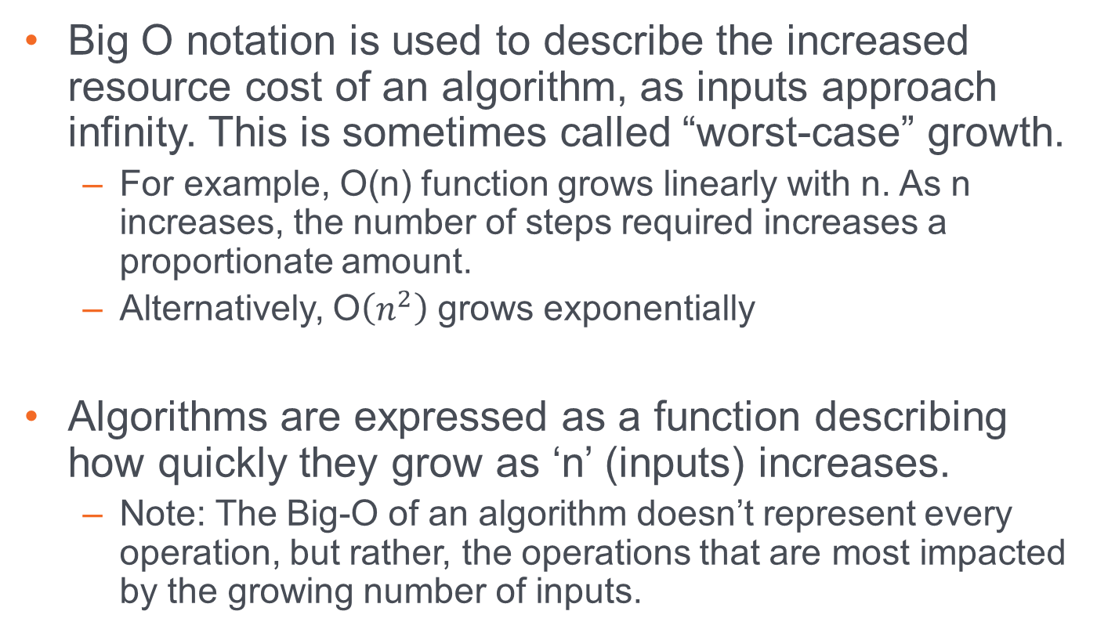
Big-O Notation
Big O notation is used to describe the increased resource cost of an algorithm, as inputs approach infinity. This is sometimes called “worst-case” growth.
For example, O(n) function grows linearly with n. As n increases, the number of steps required increases a proportionate amount.
Alternatively, O$\left(n^{2}\right)$ grows exponentially
Algorithms are expressed as a function describing how quickly they grow as ‘n’ (inputs) increases.
Note: The Big-O of an algorithm doesn’t represent every operation, but rather, the operations that are most impacted by the growing number of inputs.

Slide 14
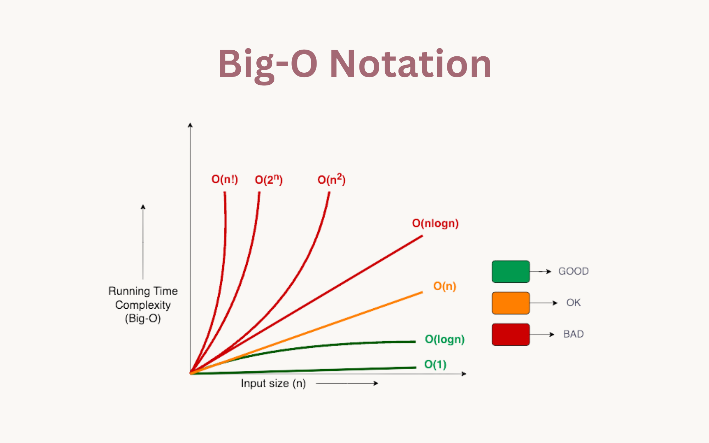
Big-O Notation - Visualized

Slide 15
Big-O and Math
Big-O can involve a bit of limit calculus and algebra. This is one the science aspects of computer science.
In most circumstances, you can avoid the crunchy mathematical details if you understand the rules involved.
Deducing the complexity of an algorithm can be done through pattern recognition most of the time.

Slide 16
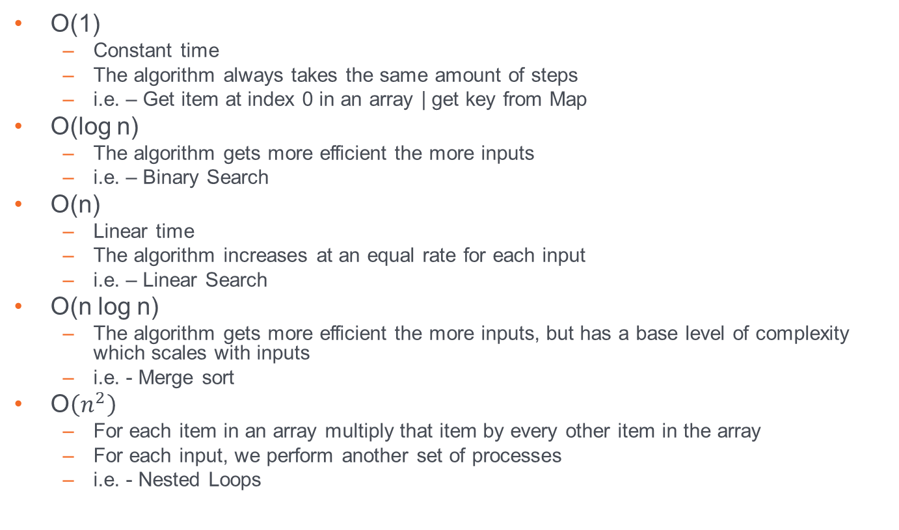
Big-O
O(1)
Constant time
The algorithm always takes the same amount of steps
i.e. – Get item at index 0 in an array | get key from Map
O(log n)
The algorithm gets more efficient the more inputs
i.e. – Binary Search
O(n)
Linear time
The algorithm increases at an equal rate for each input
i.e. – Linear Search
O(n log n)
The algorithm gets more efficient the more inputs, but has a base level of complexity which scales with inputs
i.e. - Merge sort
O$\left(n^{2}\right)$
For each item in an array multiply that item by every other item in the array
For each input, we perform another set of processes
i.e. - Nested Loops

Slide 17
Greedy Algorithms

Slide 18
Greedy Algorithms
It is important to note a term known as greedy algorithms.
A Greedy algorithm is one which always chooses the most immediate and optimal solution to satisfy the current stage, even if it is not the most optimal for the solution, as a whole.

Slide 19
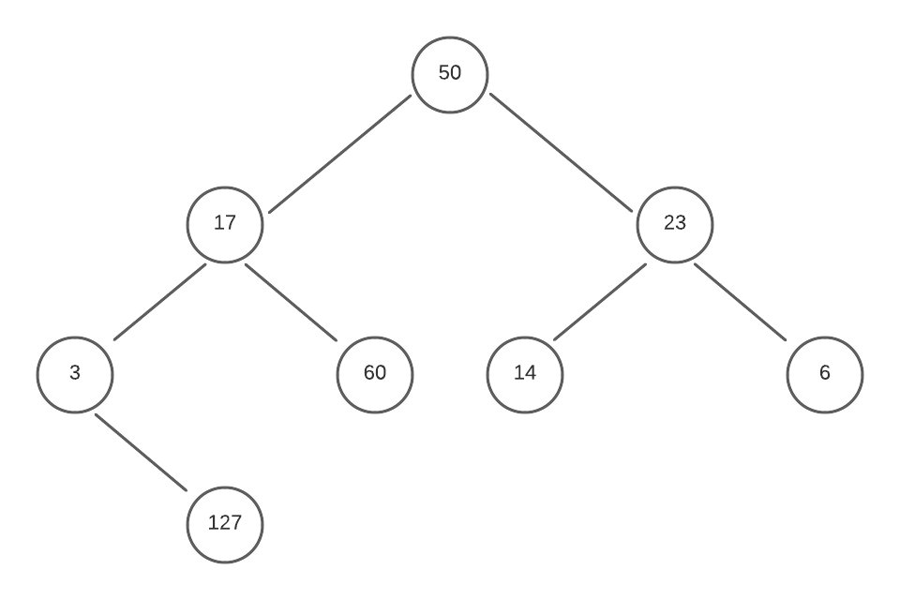
Greedy Algorithms | Example
Lets assume that we have a tree graph and we want to write a greedy algorithm to determine the maximum, total that the tree can provide as we traverse to the bottom of the tree.

Slide 20
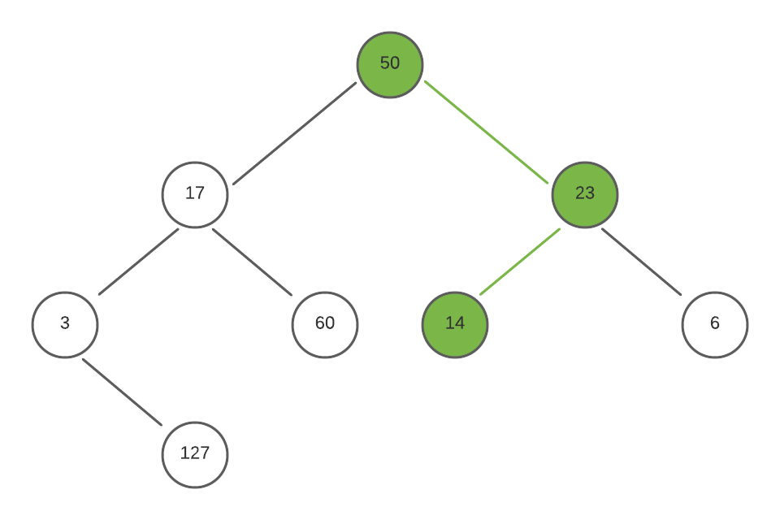
Greedy Algorithms | Example
With a greedy algorithm, we ignore the state of the solution, and instead look at the immediate best solution.
In this case, at the root node (50) there are two immediate decisions, the left, which gives the number 17, and right, which gives 23.
Here, we go right, because the number is larger, and repeat for 14, getting a total of 87.

Slide 21
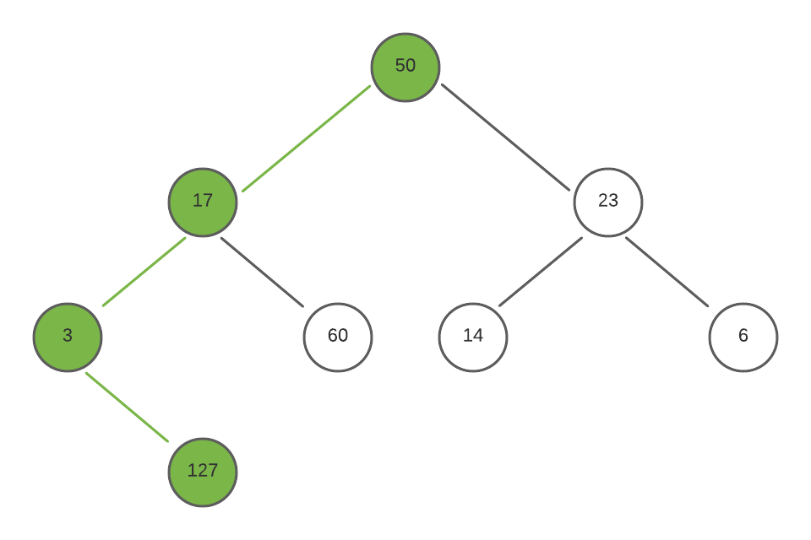
Greedy Algorithms
However, as you may notice, there is a more optimal solution overall, if we decide the sacrifice the first choice, and go down the left path to 17, then again to 3, we find a node with a value of 127, giving a total of 197.

Slide 22
Searching

Slide 23
Common Algorithms – Linear Search
Searching algorithms are methods used to find an element within some collection or list.
Linear search is the most basic searching algorithm, which functions by checking each element of a collection in sequence until a match is found or until the whole list has been searched.

Slide 24
Linear Search
public int linearSearch(Integer target, Integer[] collection) {
int index = -1;
for (int i = 0; i < collection.length; i++) {
if (collection[i] == target) {
index = i;
}
}
return index;
}

Slide 25
Linear Search (visualization)
Target
35
10
15
19
23
28
35
41
49
62

Slide 26
Common Algorithms – Binary Search
A Binary Search (a.k.a. half-interval search) is another common algorithm used to find elements within a sorted collection.
Binary search finds the position of an element by looking at the element halfway between the recognized minimum and maximum value and eliminating half of the remaining elements if the target value is less than or greater than this halfway point.
The algorithm ends after finding the target value is found or all elements have been eliminated.

Slide 27
Binary Search
public int binarySearch(Integer target, Integer[] collection) {
int left = 0;
int right = collection.length-1;
while (left <= right) {
int mid = (right+left)/2
if (target < collection[mid]) {
right = mid - 1;
} else if (target > collection[mid]) {
left = mid + 1;
} else {
return mid;
}
}
return -1; // target number doesn’t exist
}

Slide 28
Binary Search (visualization)
Target
35
10
15
19
23
28
35
41
49
62

Slide 29
Iterative Sort

Slide 30
Common Algorithms – Swapping Elements
When sorting data in any programming language, a ‘swap’ is a typical algorithm to perform and is often performed multiple times as elements are moved into order.
/* Swap position of two indexes of an array */
void swap (Object[] arr, int l_index, int r_index) {
Object temp = arr[l_index];
arr[l_index] = arr[r_index];
arr[r_index] = temp;
}

Slide 31
Swap (visualization)
void swap (Object[] arr, int l_index, int r_index) {
Object temp = arr[l_index];
arr[l_index] = arr[r_index];
arr[r_index] = temp;
}
Temp
A
A
arr[l_index]
arr[r_index]
B
A
A
B
B
A

Slide 32
Common Algorithms – Bubble Sort
Bubble Sort is one of the simplest sorting algorithms, used to organize elements of a collection into a particular order.
Bubble Sort organizes elements by repeatedly comparing and swapping adjacent elements if they are in the wrong order.

Slide 33
Bubble Sort
public void bubbleSort(Integer[] arr) {
int n = arr.length;
for (int i = 0; i < n – 1; i++) {
for (int j = 0; j < n - 1; j++) {
if (arr[j] > arr[j+1]) {
int temp = arr[j];
arr[j] = arr[j+1];
arr[j+1] = temp;
}
}
}
}

Slide 34
Bubble Sort (visualization)
compare
compare
compare
compare
10
62
19
15
28
35
23
49
41

Slide 35
Common Algorithms – Selection Sort
Selection Sort is another common sorting algorithm that organizes elements within a collection.
The Selection Sort works by repeatedly finding the smallest element of a collection and moving the found element forward by swapping the position of the left-most element, with the smaller.

Slide 36
Selection Sort
public void selectionSort(Integer[] arr) {
int n = arr.length;
for (int i = 0; i < n – 1; i++) {
int minIndex = i;
for (int j = minIndex+1; j < arr.length - 1; j++) {
if (arr[minIndex] > arr[j]) {
minIndex = j;
}
}
int temp = arr[i];
arr[i] = arr[minIndex];
arr[minIndex] = temp;
}
}

Slide 37
Selection Sort (visualization)
Target
Current
Current
Current
Current
Current
Current
Current
Current
81
52
22
18
31
48
25
67
4
Low
Low
Low
Low
Low
Low
Low
Low

Slide 38
Recursive Sorting

Slide 39
What is Recursion?
A recursive function is another method to repeat functionality by creating a function which calls itself, and returns the output
Successive executions are added to the execution stack
There must exist a base case at which the recursion stops, otherwise you will get a stack overflow
When the base case is found, values are returned down the execution stack, potentially being transformed along the way.
int recursion(int n ) {
if (n <= 0)
return 0; else
return recursion(--n);
}

Slide 40
Recursion Example: Fibonacci Sequence
The Fibonacci sequence is a series of numbers that starts “0, 1, …” and every subsequent number is the sum of the prior two. (0, 1, 1, 2, 3, 5, 8, 13, 21…)
Goal: Calculate the nth index of the Fibonacci sequence.
Base case: n === 0 -> 0
Base case: n === 1 -> 1
Otherwise: fib(n-2)+fib(n-1)
function fib( n) {
if (n <= 0)
return 0; else if (n === 1)
return 1;
else
return (fib(n-2) + fib(n-1));

Slide 41
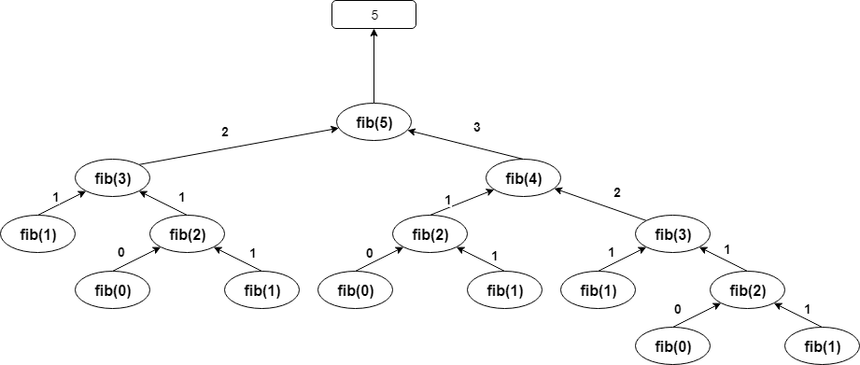
Fib(5)

Slide 42
Why Use Recursion?
Recursion can simplify a number of algorithms once you get used to it.
If an algorithm involves repeated steps, the repetitive part can be isolated recursively.
Is recursion more efficient?
Not really! Most recursive algorithms can also be expressed iteratively (with loops)
So does recursion save memory…?
Not at all! Every recursive invocation of a function places a new copy of that method on the stack.
So why ever use it…?
A recursive approach can make some problems much easier to comprehend and solve.
There are a few circumstances where recursion is virtually mandatory. Compilers use recursion extensively.

Slide 43
Common Algorithms – Merge Sort
The Merge Sort is a more complex sorting algorithm that organizes elements of a collection by dividing continually dividing a collection into two halves, and then merging the split collections back together in sorted order.
The Merge sort relies on using recursion to repeatedly partition data into auxiliary collections before combining the values back together into a single collection.

Slide 44
Merge Sort
void merge(Integer arr[], int l, int m, int r) {
/* Find Sizes of two sub-arrays to be merged */
int n1 = m - l + 1;
int n2 = r - m;
/* Create temp arrays */
int[] L = new int[n1];
int[] R = new int[n2];
/* Copy data to temp arrays */
for (int i = 0; i < n1; ++i) L[i] = arr[l + i];
for (int j = 0; j < n2; ++j) R[j] = arr[m + 1 + j];
/* Merge the temp arrays */
int i = 0, j = 0; // Initial indexes of first and second subarrays
int k = l; // Initial index of merged subarry array
while (i < n1 && j < n2) {
if (L[i] <= R[j]) {
arr[k] = L[i];
i++;
} else {
arr[k] = R[j];
j++;
}
k++;
}
/* Copy remaining elements of L[] if any */
while (i < n1) {
arr[k] = L[i];
i++;
k++;
}
/* Copy remaining elements of R[] if any */
while (j < n2) {
arr[k] = R[j];
j++;
k++;
}
}
void sort(Integer arr[], int l, int r) {
if (l < r) {
// Find the middle point
int m = l + (r - l) / 2;
// Sort first and second halves
sort(arr, l, m);
sort(arr, m + 1, r);
// Merge the sorted halves
merge(arr, l, m, r);
}
}

Slide 45
Merge Sort (visualization)
51
17
22
45
37
91
5
72

Slide 46
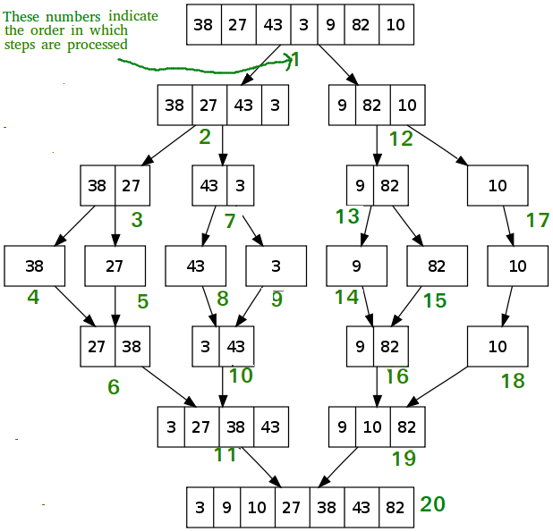
Merge Sort (visualization)

Slide 47
Other Examples

Slide 48
More Algorithms…
Quick Sort – Recursive Algorithm which swaps elements based on a ‘partition’.
Insertion Sort – Iterative Algorithm which moves lower elements toward the front by swapping their position with higher elements and continuing until the lower element is in the correct position.
Counting Sort – Iterative Algorithm that sorts elements of an array by counting the number of occurrences of each unique element and storing values in an auxiliary Array. Then we use the index of the auxiliary array to map the sorted output.
Tim Sort – Recursive Algorithm which combines both Insertion sort and Merge sort to organize elements in blocks, known as ‘Runs’, and merging sorted blocks together.
And more…
Practice, Study and Experience

Slide 49
Algorithm Big-O
Linear Search
Time Complexity : O(n) – linear
Space Complexity : O(1) – Constant
Binary Search
Time Complexity : O(log n) – Logarithmic
Space Complexity : O(1) – Constant
Swap Elements
Time Complexity : O(1) – Constant
Space Complexity : O(1) – Constant
Bubble Sort
Time Complexity : O(n^2) – Exponential
Space Complexity : O(1) – Constant
Selection Sort
Time Complexity : O(n^2) – Exponential
Space Complexity : O(1) – Constant

Slide 50
Algorithm Big-O
Merge Sort
Time Complexity : O(n log(n)) – N times logarithm of N
Space Complexity : O(n) – Linear
Quick Sort
Time Complexity : O(n^2) – Exponential
Space Complexity : O(n) – Linear
Insertion Sort
Time Complexity : O(n^2) – Exponential
Space Complexity : O(1) – Constant
Counting Sort
Time Complexity : O(N+K) – Complexity is dependent on the size of the collection and the range of the values within the collection.
Space Complexity : O(k) – Complexity can vary depending on the range different of values. N = number of element. K = range for elements.
N = number of elements
K = Range of elements (largest – smallest)
Tim Sort
Time Complexity : O(n log(n)) – N times logarithm of N
Space Complexity : O(1) – Constant

